Slide 1


DNA transcription
Lecture 10 & 11
Dr. Rawa Abdul Redha Aziz
Ph.D Antibiotics/ Molecular biology

Slide 2
History
A molecule that allows the genetic material to be realized as a protein was first hypothesized by François Jacob and Jacques Monod. Severo Ochoa won a Nobel Prize in Physiology or Medicine in 1959 for developing a process for synthesizing RNA in vitro with polynucleotide phosphorylase, which was useful for cracking the genetic code. RNA synthesis by RNA polymerase was established in vitro by several laboratories by 1965; however, the RNA synthesized by these enzymes had properties that suggested the existence of an additional factor needed to terminate transcription correctly.

Slide 3
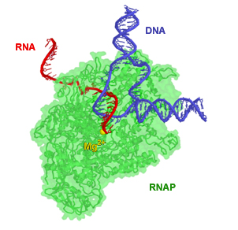

Slide 4
Transcription Process
1-Initiation
-Transcription begins with the binding of RNA polymerase, together with one or more general transcription factors, to a specific DNA sequence referred to as a "promoter" to form an RNA polymerase-promoter "closed complex". Here, the promoter DNA is still fully double-stranded. This complex then will unwind approximately 14 base pairs of DNA to form “open complex”. In this new complex the promoter DNA is partly unwound and be single-stranded so it will be referred to as the "transcription bubble."

Slide 5
Promoters in bacteria, the promoter contains two short sequence elements approximately 10 (Pribnow Box) and 35 nucleotides upstream from the transcription start site
The sequence at -10 (the -10 element) has the consensus sequence TATAAT.
The sequence at -35 (the -35 element) has the consensus sequence TTGACA.

Slide 6
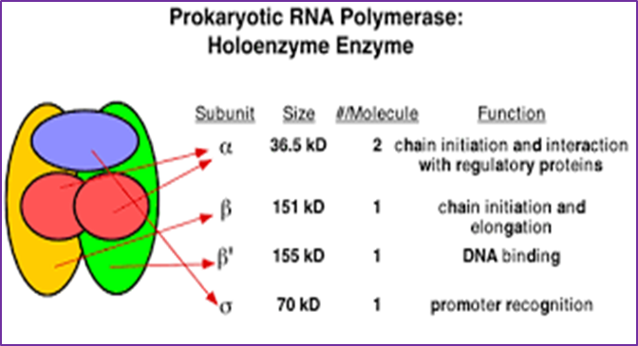
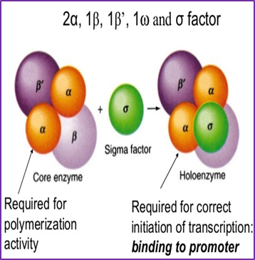

Slide 7
Promoters in Eukaryotes are diverse and can be difficult to characterize, however, recent studies show that they are divided in more than 10 classes. Gene promoters are typically located upstream of the gene and can have regulatory elements several kilobases away from the transcriptional start site (enhancers). In eukaryotes, the transcriptional complex can cause the DNA to bend back on itself, which allows for placement of regulatory sequences far from the actual site of transcription. Eukaryotic RNA-polymerase-II-dependent promoters can contain a TATA element (consensus sequence TATAAA), which is recognized by the general transcription factor TATA-binding protein (TBP); and a B recognition element (BRE), which is recognized by the general transcription factor TFIIB. The TATA element and BRE typically are located close to the transcriptional start site (typically within 30 to 40 base pairs

Slide 8
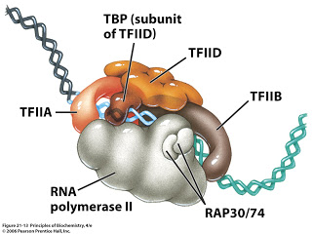

Slide 9
2-Promoter escape
-In bacteria, upon and following promoter clearance, the σ factor is released according to a stochastic model.
-In eukaryotes, at an RNA polymerase II-dependent promoter, upon promoter clearance, TFIIH phosphorylates serine 5 on the carboxy terminal domain of RNA polymerase II, leading to the recruitment of capping enzyme (CE). The exact mechanism of how CE induces promoter clearance in eukaryotes is not yet known.

Slide 10

3-Elongation

Slide 11
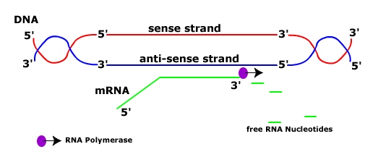

Slide 12
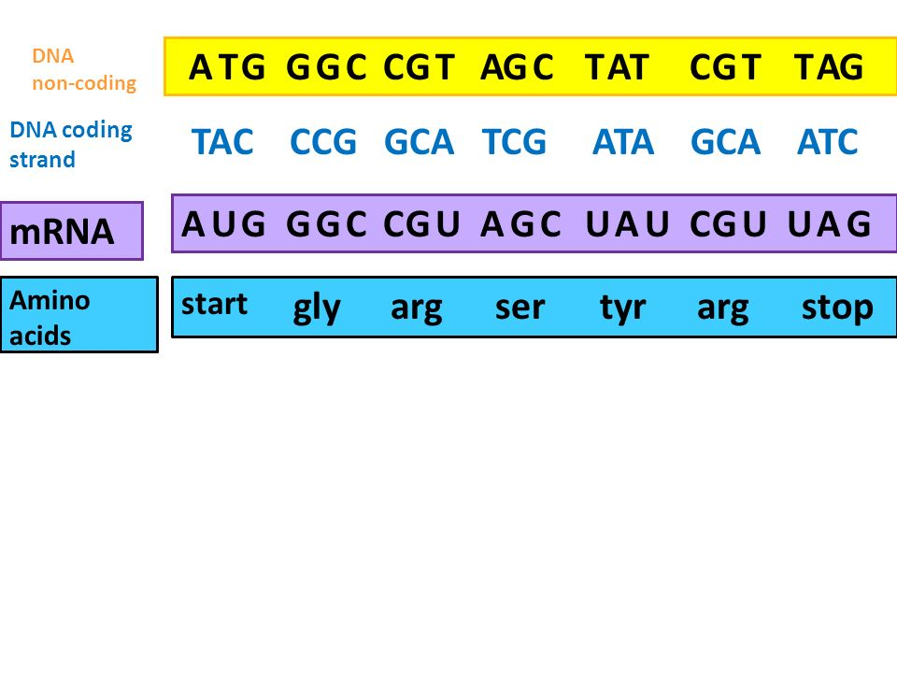

Slide 13
4- Termination
Bacteria use two different strategies for transcription termination [Rho-independent termination and Rho-dependent termination].
Rho-independent transcription termination
Rho-dependent transcription termination
In eukaryotes, transcription termination is less well understood than in bacteria, but involves cleavage of the new transcript followed by template-independent addition of adenines at its new 3' end, in a process called polyadenylation

Slide 14
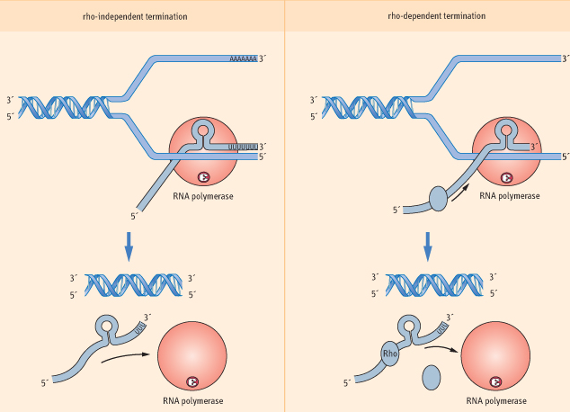

Slide 15
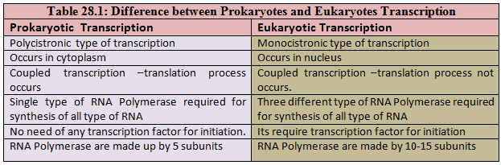

Slide 16
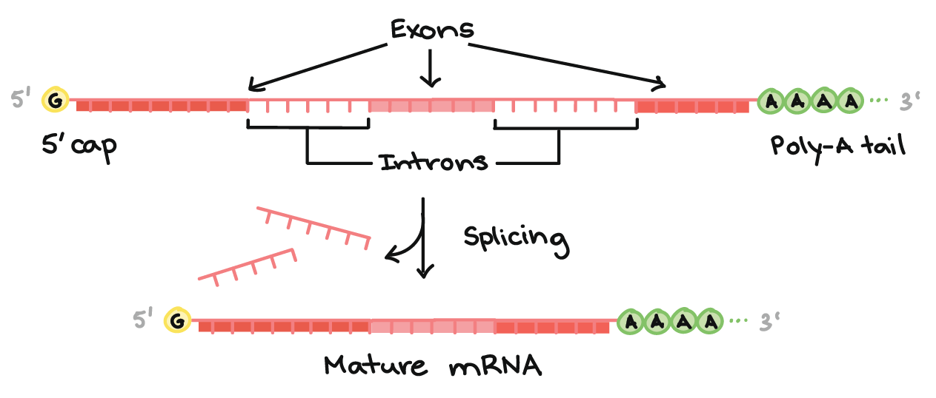
Post OR Co transcriptional modification

Slide 17
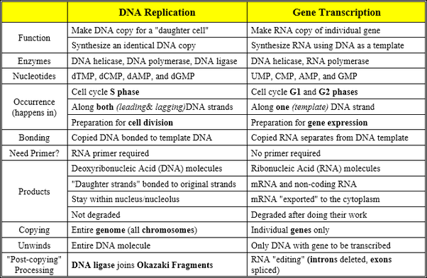

Slide 18


